Slide 1
Additional Features of Arrays

Slide 2
Two-Dimensional Arrays
We’ve covered one-dimensional arrays or vectors.
Visualized as a series of values laid out in a column
Single subscript used to select array element.
A two-dimensional array is a FORTRAN mechanism designed to hold data of more than one dimension.
Also called a rank-2 array
Or a matrix.
Rank-2 arrays elements are addressed with two subscripts. A(I,J)

Slide 3

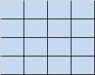
One- and Two-Dimensional Arrays
One-Dimensional Array
Two-Dimensional Array
Row 1
Row 1
Row 2
Row 2
Row 3
Row 3
Row 4
Row 4
Col 1
Col 2
Col 3
Col 4
a1(irow)
a2(irow, icol)

Slide 4
Declaring Rank-2 Arrays
The type and size of a rank-2 array must be declared.
Examples:
REAL, DIMENSION(3, 6) :: sum
INTEGER, DIMENSION(0:100, 0:20) :: hist
CHARACTER(len=6), DIMENSION(-3:3, 10) :: counts

Slide 5

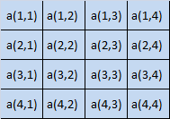
Rank-2 Array Storage
FORTRAN always allocates array elements in column major order.
Row 1
Notional Arrangement in computer memory
Row 2
Row 3
Row 4
Col 1
Col 2
Col 3
Col 4

Slide 6
Initializing Rank-2 Arrays
Assignment statements
Type declaration statements
FORTRAN Read statements

Slide 7

Assignment Statement Initialization
Initialization on an element-by-element basis:
Initialization using an array constructor:
Suppose I want to initialize a (4,3) array called A1
A1 = [1, 1, 1, 1, 2, 2, 2, 2, 3, 3, 3, 3]
Array constructors always produced rank-1 arrays
The array can be changed from a vector to a rank-2 array using a special FORTRAN intrinsic function called RESHAPE

Slide 8
RESHAPE Function
Function changes the shape of an array without changing the number of elements in it.
The form of RESHAPE is:
Output = RESHAPE(array1, array2)
array1 contains the data to reshape
array2 is a rank-1 array describing the new shape
The number of elements in array1 must be the same number of elements in the shape specified in array2.
Example:
A1 = RESHAPE ( [1,1,1,1,2,2,2,2,3,3,3,3], [4,5] )
RESHAPE maps the elements from the old shape to the new shape in column major order.

Slide 9
TYPE Declaration Initialization
When initialized, array data is loaded into memory in column order.
Values listed in the type declaration must be in column order.
Remember, that an array constructor creates a vector.
The RESHAPE function must be used to reshape the vector into the same shape as the declared array.
INTEGER, DIMENSION(4,3) :: a1 = &
RESHAPE ( [1,1,1,1,2,2,2,2,3,3,3,3], [4,3])

Slide 10
READ Statement Initialization
Example - 1: READ(*,*) a1
Array name appears without subscripts in the argument list of a READ.
Program will attempt to read values from all of the elements in the array
Values assigned to the array elements in column order.
Example – 2: READ(*,*) ((a1(i,j), j = 1,3), i = 1,4)
Implied DO loops may be used to change the order in which array elements are initialized.
They may also be used to initialize only a portion of an array.

Slide 11
Whole Array Operations and Subsets
Two-dimensional arrays may be used together in arithmetic operations.
They must be conformable (have the same shape)
Do not have to have the same subscript range.
Operations are applied on an element by element basis.
Scalar values are also conformable.

Slide 12
Multidimensional or Rank-n Arrays
FORTRAN supports more complex arrays with up to 7 different subscripts.
These large arrays are declared, initialized, and used in the same manner as rank-2 arrays.
Rank-n arrays are notionally allocated in memory in a manner that is an extension of the column order used by rank-2 arrays.

Slide 13
Using FORTRAN Intrinsic Functions with Arrays
Elemental functions
Inquiry functions
Transformational functions

Slide 14
Elemental Intrinsic Functions
Functions that can take scalar and array arguments.
If the argument is a scalar the result is a scalar
If the argument is an array
Result is an array
Resultant array is the same shape as the input array
If there is more than one input argument then all the inputs must be the same shape.
Function is applied on an element by element basis

Slide 15
Inquiry Intrinsic Functions
Functions whose value depended on the properties of an object being investigated.
Useful in determining the properties of an array.
Example:
UBOUND(arr) – returns the largest subscript(s) of array arr

Slide 16
Transformational Intrinsic Functions
Functions that have one or more array-valued arguments or an array-valued result.
Operate on arrays as a whole.
Output is often does not have the same shape as the input arguments
Examples: RESHAPE and DOT_PRODUCT

Slide 17
Masked Array Assignment
Suppose we want to work on some of the elements in an array but not all of them.
Use a series of DO loops and IF statements
Perform the calculation all at once using a masked array assignment.
A masked array assignment operation
controlled by a logical array the same shape as the array in the assignment.
Preformed only for elements of the array that correspond to TRUE values in the MASK

Slide 18
The Where Construct
[Name:] WHERE (mask_expr1)
Array Assignment statement(s)
ELSEWHERE (mask_expr2) [name]
Array Assignment statement(s)
ELSEWHERE [name]
Array Assignment statement(s)
END WHERE [name]
The general form:
At most one block of statements will be executed for any given element in the array.
The WHERE Statement:
WHERE (mask_expr) Array Assignment Statement

Slide 19
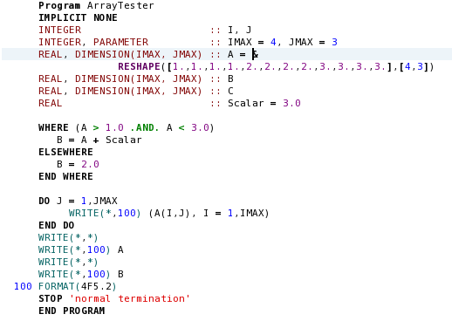
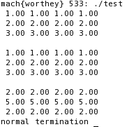
WHERE Construct Example:

Slide 20
The FORALL Construct
Construct permits operations on an element-by-element basis to a subset of elements in an array.
General form:
The FORALL Statement:
[name:] FORALL (in1=triplet1,[in2=triplet2, … logical_expr])
statement-1
statement-2
…
statement-n
END FORALL [name]
FORALL (in1=triplet1,[in2=triplet2, … logical_expr]) Assignment Statement

Slide 21
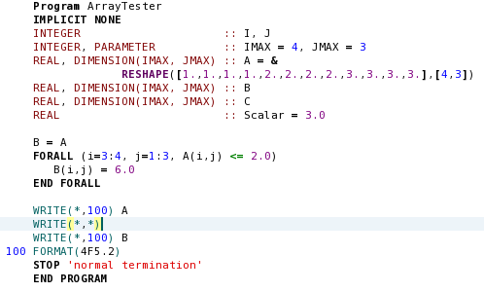
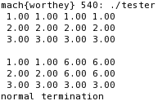
FORALL Construct Example:

Slide 22
The Significance of the FORALL Construct
Any expression written in a FORALL construct could also be written as a set of nested DO loops combined with IF blocks.
So why do it ?
Speed !!!
The statements in the DO loop structure must be executed in strict order
Statements in the FORALL construct may be executed in any order selected by the processor.
This freedom is of great benefit in parallel processing.

Slide 23
Allocatable Arrays
Static memory allocation:
Array size declared in the type declaration statements.
Size set at compilation.
Never Changes.
Must be big enough for largest problem.
Modified by changing a few parameters and recompile.
Dynamic memory allocation:
Dynamically sets size of arrays during execution.
Minimizes computer memory requirements

Slide 24
FORTRAN 95 Allocatable Arrays
Declared using the ALLOCATABLE attribute in the type declaration statement.
During execution, the actual size is specified using an ALLOCATION statement:
STAT=clause (optional)
Returns 0 if successful
Positive integer if process fails
REAL, ALLOCATABLE, DIMENSION( : , : ) :: arr1
ALLOCATE ( list of arrays to allocate, STAT=status)

Slide 25
Some More Array Definitions
Deferred shape array:
Declared with colons for dimensions
Actual shape deferred until memory is allocated.
Explicit shape array:
Size explicitly declared in type declaration.

Slide 26
Allocatable Arrays
May not be used until memory is allocated.
Intrinsic function ALLOCATED() used to test if array is allocated.
Deallocate array when no longer needed.
Note: Use of allocatable arrays in real time software can cause problems.
DEALLOCATE ( list of arrays to allocate, STAT=status)

Slide 27
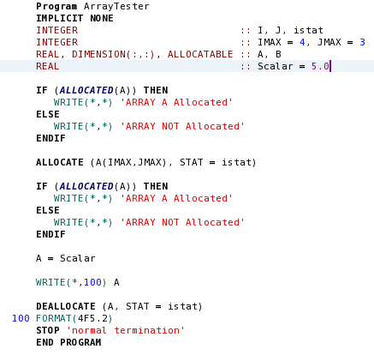

F95 Allocatable Array Example:

Slide 28
FORTRAN 2003 Allocatable Arrays
There are two forms of allocation statements in 2003:
The first form is:
This form is very similar to the 95 statement.
ERRMSG clause:
Writes a descriptive message indicating the problem.
ALLOCATE ( list of arrays, STAT=istatus, ERRMSG=err_msg)

Slide 29
2nd Form of 2003 Allocation
ALLOCATE ( arr1, SOURCE=arr2, STAT=istatus, ERRMSG=err_msg)
Allocates arr1 to be the same size and shape as arr2.
Initializes content of arr1 to the same as arr2.
Can only allocate one array at a time.
Arr1 must be the same size and shape as Arr2.

Slide 30
Automatic Array Allocation
New in FORTRAN 2003
Arrays can be allocated and deallocated automatically in normal program assignments.
Assigning an expression of the same rank to an allocatable array causes the array to be
Automatically allocated to the correct shape if unallocated.
Automatically deallocated and reallocated to the correct shape if it was previously allocated with and incompatible shape.

Slide 31
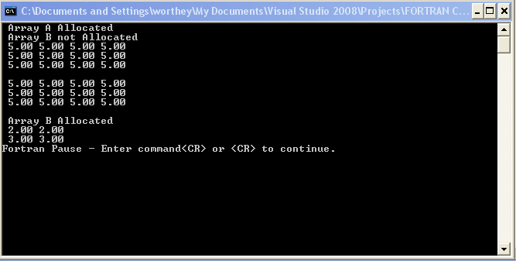
Automatic Array Allocation
Program ArrayTester
IMPLICIT NONE
INTEGER :: I,J,istat
INTEGER :: IMAX = 4, JMAX = 3
REAL, DIMENSION(:,:), ALLOCATABLE :: A,B
REAL, DIMENSION(2,2) :: C = RESHAPE([2.,2.,3.,3.],[2,2])
REAL :: Scalar = 5.0
CHARACTER(LEN=80) :: ich
ALLOCATE (A(IMAX, JMAX), STAT = istat, ERRMSG = ich)
IF (ALLOCATED(A)) THEN
WRITE(*,*) 'Array A Allocated'
A = Scalar
ELSE
WRITE(*,*) 'Array A NOT Allocated'
PAUSE
STOP 'Program Error - Array not ALLOCATED'
END IF
IF (ALLOCATED(B)) THEN
WRITE(*,*) 'Array B Allocated'
ELSE
WRITE(*,*) 'Array B not Allocated'
END IF
WRITE(*,100) A
WRITE(*,*)
B = A
WRITE(*,100) B
WRITE(*,*)
IF (ALLOCATED(B)) THEN
WRITE(*,*) 'Array B Allocated'
ELSE
WRITE(*,*) 'Array B not Allocated'
END IF
B = C
WRITE(*,101) B
Pause
DEALLOCATE(A, B, STAT = istat)
100 FORMAT(4F5.2)
101 FORMAT(2F5.2)
END PROGRAM ArrayTester

Slide 32
Good Coding Practice
Use RESHAPE to change the shape of an array
Use WHERE constructs to modify and assign selected array elements.
Use allocatable arrays to produce programs that automatically adjust their memory requirements based on problem size.
Always use the ISTAT clause
Always use the ERRMSG clause
Always DEALLOCATE allocatable arrays when done.

